Slide 1

DriverPass System Analysis
Allen Fox
Notes:
[No speaker notes required for this slide.]

Slide 2

System Requirements
Nonfunctional Requirements
Performance - System should run smooth and be designed to support multiple users at the same time
Usability - System should be easily understood by various level of users.
Scalability - The system should be able to expand both in number of users as well as number of classes stored
Availability - System should be able to support all users on a 24/ 7 scale.
Functional Requirements
Users Registration and account setup - Users need to add their information and set up a user account
Alerts, notifications, and messaging - Users should be able to receive alerts when new classes are available, assignments or training is due.
Course listings and management - A full catalog of courses available to take as well as a system that manages courses that tie together.
Course calendar and scheduling - A system that helps keep courses, assignments, training, and classes on track.
Notes:
[In your speaker notes, include an explanation of the different requirements you determined for DriverPass’s system. What are the functional requirements you selected to describe? What are the nonfunctional requirements you selected to describe? Be sure to explain how these requirements meet DriverPass’s needs.]

Slide 3
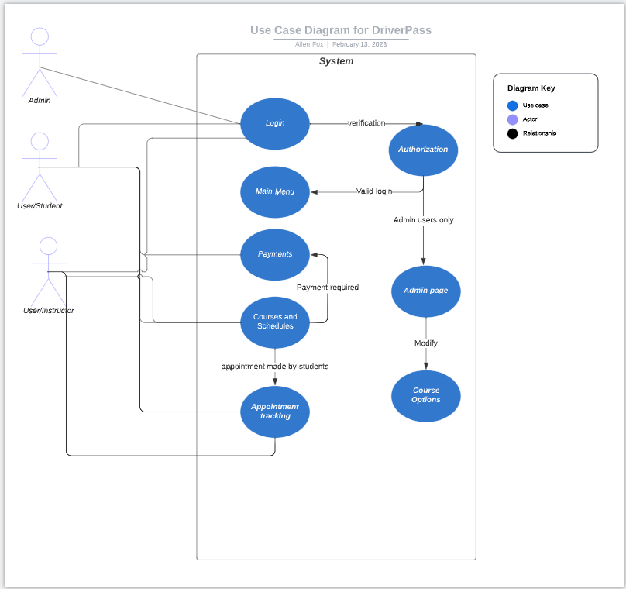
Use Case Diagram
Notes:
[Explain your diagram. Who are the different actors in the system? What are the different use cases? How did you account for DriverPass’s needs in your design? In your explanation, keep your audience in mind. Avoid the use of terms like “actors” and “use cases” in your explanation.]

Slide 4
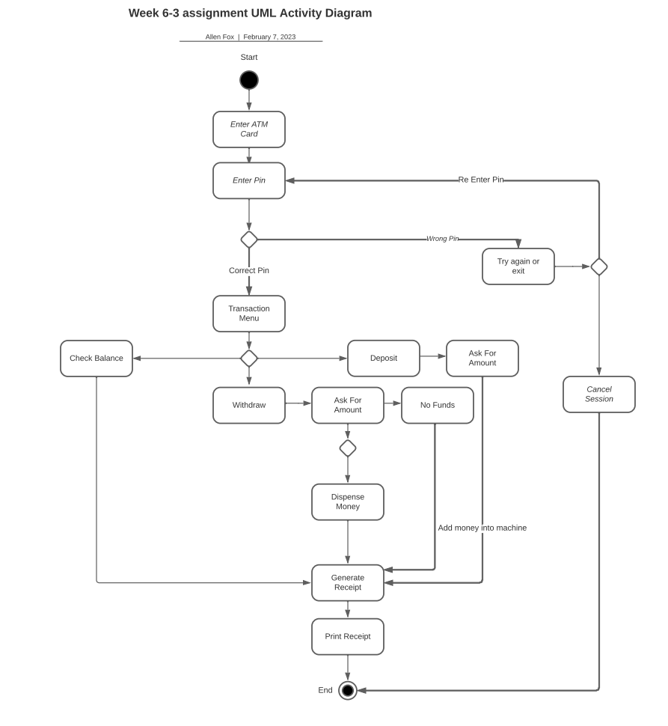
Activity Diagram
Notes:
[Explain your diagram. Which use case are you breaking down? What are the steps for this use case? How did you account for DriverPass’s needs in your design? In your explanation, keep your audience in mind. Avoid the use of technical terms such as “nodes,” “control flows,” and so on.]

Slide 5
Security
Server will be using HTTPS as well as a firewall.
User will be logging with username and password if successful than 2-way authentication will send a code to finalize the login.
After 3 failed attempts account will be locked out and the user will have to call IT support for password reset or use the password reset tool online.
System should track IP location as another way to prevent hacked accounts or hacks from other countries.
Notes:
[How did you consider security in your design? In your explanation, keep your audience in mind by avoiding the use of technical terms.]

Slide 6
System Limitations
Users’ needs - Multiple ways to review course material, study guides based on learning preference. Visual, audible, text, video, etc
Hardware obsolescence - As technology advances a plan should be in place to replace the hardware before the ability to repair and maintain as completely diminished.
Notes:
[What are the limitations of your design? In your explanation, keep your audience in mind by avoiding the use of technical terms.]

